Slide 1
The Logic of Quantified Statements
Session 4
Course : MATH6182 – Discrete Mathematics
Effective Period : September 2021

Slide 2
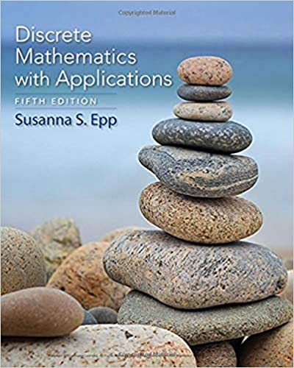
These slides have been adapted from :
Susanna S.Epp, “ Discrete Mathematics with Applications”, 5th edition,2020, Cengage, Boston, USA, ISBN 9781337694193
Chapter 3
Acknowledgement

Slide 3

Learning Objectives
On successful completion of this Course, students will be able to:
LO1:
Explain the logic of compound statements, digital logic circuits, and quantified statements

Slide 4
Sub Topics
1
Predicates and Quantified Statements I
2
Predicates and Quantified Statements II
3
Statements with Multiple Quantifiers

Slide 5
Predicates And Quantified Statements I
…It Was Not Till Within The Last Few Years That It Has Been Realized How Fundamental Any And Some Are To The Very Nature Of Mathematics. —A. N. Whitehead (1861–1947)

Slide 6
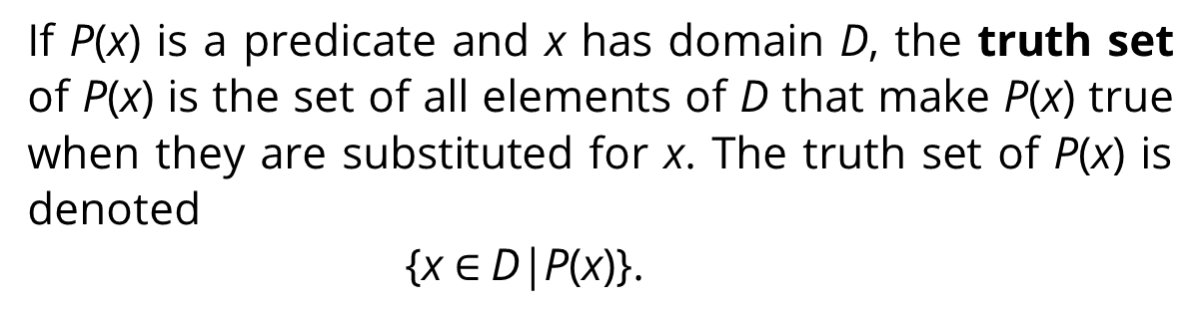
Predicates
Definition
A predicate is a sentence that contains a finite number of variables and becomes a statement when specific values are substituted for the variables. The domain of a predicate variable is the set of all values that may be substituted in place of the variable.
Definition
If P(x) is a predicate and x has domain D, the truth set of P(x) is the set of all elements of D that make P(x) true when they are substituted for x. The truth set of P(x) is denoted
{x $∈$D|P(x)}.

Slide 7
Finding Truth Values
of a Predicate
Let P(x) be the predicate "x² > x" with domain the set R of all real numbers. Write P(2), P(1/2), P(-2), and indicate which of these propositions are true and which are false!
Solution :
P(2) : 2² > 2 or 4 > 2. True
P(1/2) : (1/2) ² > (1/2) or (1/4) > (1/2). False
P(-2) : (-2)² > 2 or 4 > 2. True

Slide 8
The Truth Set of The
Predicate
Let Q(n) be the predicate “n is a factor of 8.” Find the truth set of Q(n) if
a. the domain of n is the set Z+ of all positive integers
b. the domain of n is the set Z of all integers.
Solution :
a. The truth set is {1, 2, 4, 8} because these are exactly the positive integers that divide 8 evenly.
b. The truth set is {1, 2, 4, 8,−1,−2,−4,−8} because the negative integers−1,−2,−4, and −8 also divide into 8 without leaving a remainder. ■

Slide 9
Change Predicates
Into Propositions
One sure way to change predicates into propositions is to assign specific values to all their variables.
Example :
If x represents the number 35, the sentence
"x is (evenly) divisible by 5“
is a true propositions since 35 = 5٠7.
Another way to obtain propositions from predicates is to add quantifiers.
Quantifiers are words that refer to quantities such as "some" or "all" and tell for how many elements a given predicate is true.

Slide 10
The Universal Quantifier, ∀
The symbol ∀ is called the universal quantifier. it is read as “for every,” “for each,” “for any,” “given any,” or “for all.”
Example :
The sentence "All human beings are mortal" is to write
∀ human beings x, x is mortal
or, more formally
∀x ∈ S, x is mortal,
and read “ For all x in S, x is mortal “
where S denotes the set of all human beings.

Slide 11
Truth and Falsity of
Universal Proposition
Definition
Let Q(x) be a predicate and D the domain of x. A universal proposition is a proposition of the form
"∀x ∈ D, Q(x)“.
It is defined to be true if, and only if, Q(x) is true for every x in D.
It is defined to be false if, and only if, Q(x) is false for at least one x in D.
A value for x for which Q (x) is false is called a counter example to the universal proposition.

Slide 12
Truth and Falsity of Universal
Proposition
Example :
a. Let D = {1, 2, 3,4, 5}, and consider the proposition “∀x ∈ D, x² ≥ x”
Show that this proposition is true.
b. Consider the proposition ∀x ∈ R, x² ≥ x. Find a counter example to
show that this proposition is false.
Solution:
Check that "x² ≥ x" is true for each individual x in D.
1² > 1, 2² > 2, 3² > 3, 4² > 4, 5² > 5.
Hence " ∀x ∈ D,x² ≥ x " is true.
b. Counter example: Take x = 1/2. Then x is in R (since 1/2 is a real number) and
hence "∀x ∈ R, x² ≥ x " is false.

Slide 13
The Existential Quantifier, ∃
The symbol ∃ denotes "there exists" and is called the existential quantifier.
Example:
The sentence "There is a student in Math 140" can be written as
∃ a person s such that s is a student in Math 140,
or more formally,
∃ s∈S such that s is a student in Math 140,
where S is the set of all people.
Some other expressions that can be used in place of there exists are there is a, we can find a, there is at least one, for some, and for at least one.

Slide 14
Truth and Falsity of Existential
Proposition
Definition
Let Q(x) be a predicate and D the domain of x. An existential proposition is a proposition of the form
"∃ x ∈ D such that Q(x)“.
It is defined to be true if, and only if, Q(x) is true for at least one x in D.
It is defined to be false if, and only if, Q(x) is false for all x in D.

Slide 15
Truth and Falsity of Existential Proposition
Example :
a. Consider the proposition “∃ m ∈ Z such that m² = m”.
Show that this proposition is true.
b. Let E = {5, 6, 7, 8, 9} and consider the statement “∃ m ∈ Z such that m² = m”. Show that this proposition is false.
Solution :
a. Observe that 1² = 1. Thus"m² = m" is true for at least one integer m. Hence “∃ m ∈ Z such that m² = m” is true.
b. Note that m² = m is not true for any integers m from 5 to 9 :
5² = 25 ≠ 5, 6² = 36 ≠ 6, 7² = 49 ≠ 7, 8² = 64 ≠ 8, 9² = 81 ≠ 9. Thus “∃ m ∈ Z such that m² = m” is false.

Slide 16
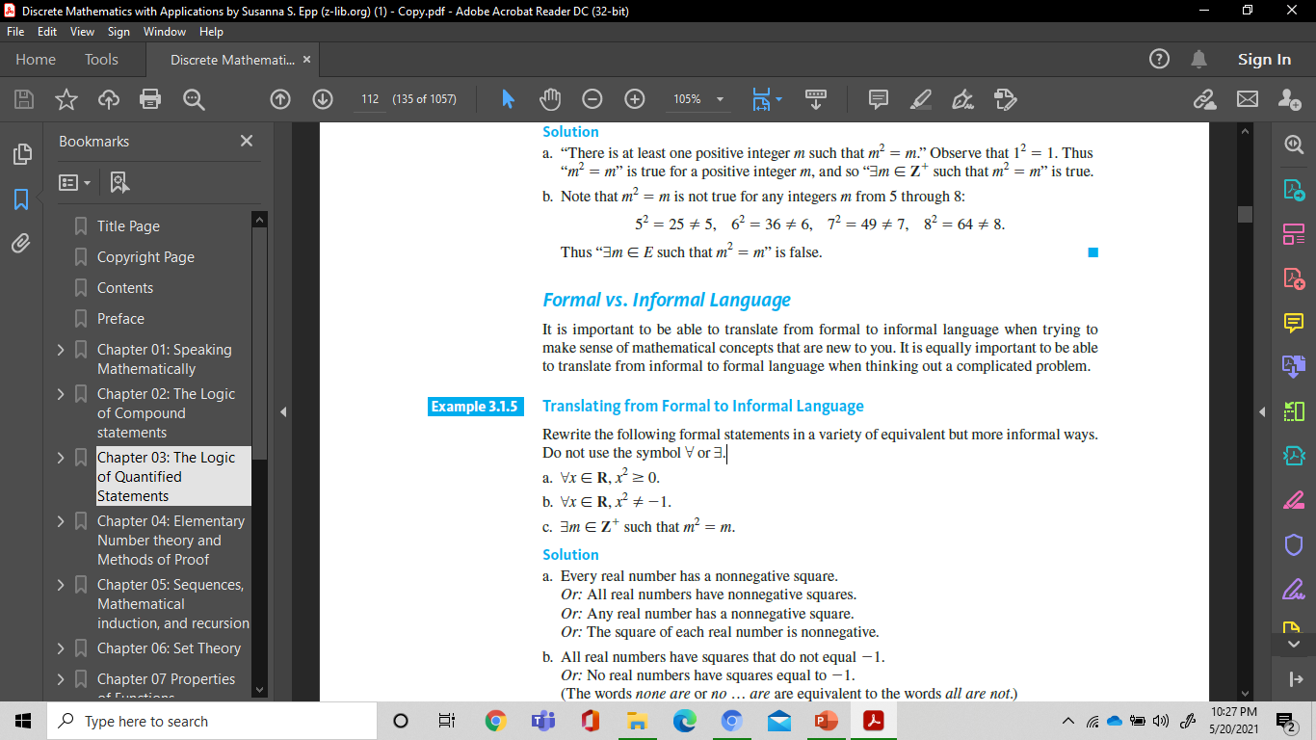
Translating from Formal to Informal Language
Example :
Rewrite the following formal statements in a variety of equivalent but more informal ways.
Do not use the symbol ∀ or ∃.
Solution :
a. Every real number has a nonnegative square.
Or : All real numbers have nonnegative squares.
Or : Any real number has a nonnegative square.
Or : The square of each real number is nonnegative.

Slide 17
Translating from Formal to Informal Language (2)
Solution :
b. All real numbers have squares that do not equal -1.
Or : No real numbers have squares equal to -1.
(The words none are or no … are are equivalent to the words all are not.)
c. There is a positive integer whose square is equal to itself.
Or : We can find at least one positive integer equal to its own square.
Or : Some positive integer equals its own square.
Or : Some positive integers equal their own squares. ■

Slide 18
Translating from Informal to Formal Language
Example :
Rewrite each of the following statements formally. Use quantifiers and variables.
a. All triangles have three sides.
b. No dogs have wings.
c. Some programs are structured.
Solution :
∀t∈T, t has three sides
(where T is the set of all triangles).
∀d∈D, d does not have wings
(where D is the set of all dogs).
∃p∈P such that p is structured
(where P is the set of all programs).

Slide 19
Universal Conditional
Propositions
A reasonable argument can be made that the most important form of proposition in mathematics is the universal conditional proposition:
∀x, if P(x) then Q(x)
Example :
Rewrite the following statement informally, without quantifiers or variables.
∀x ∈ R, if x > 2 then > 4.
Solution :
If a real number is greater than 2 then its square is greater than 4. or
The square of any real number greater than 2 is greater than 4.

Slide 20
Predicates And Quantified Statements II

Slide 21
Negation of a Universal
Statement
Theorem
The negation of a statement of the form
∀ x in D, Q(x)
is logically equivalent to a statement of the form
∃ x in D such that ~Q(x).
Symbolically,
~(∀ x ∈ D, Q(x)) ≡ ∃ x ∈ D such that ~Q(x).
Example:
A formal negations for the proposition
“∀ primes p, p is odd”
is
“∃ a prime p such that p is not odd”.

Slide 22
Negation of an Existential
Proposition
Theorem
The negation of a statement of the form
∃x in D such that Q(x)
is logically equivalent to a statement of the form
∀x in D,~Q(x).
Symbolically,
~(∃x in D such that Q(x)) ≡ ∀x in D,~Q(x).
Example :
A formal negations for the statement
“∃ a triangle T such that the sum of the angles of T equals 200°”.
is
“∀ triangles T, the sum of the angles of T does not equal 200° ”.

Slide 23
More Negations
Rewrite the following statements formally. Then write formal and informal negations.
a. No politicians are honest.
b. The number 1,357 is not divisible by any integer between 1 and 37.
Solution :
a. Formal version (1): ∀ politicians x, x is not honest.
Formal negation (2): ∃ a politician x such that x is honest.
Informal negation (3) : Some politicians are honest.
b. (1) ∀ integer n between 1 and 37, 1,357 is not divisible by n.
(2) ∃ an integer n between 1 and 37 such that 1,357 is divisible by n.
(3) The number 1,357 is divisible by some integer between 1 and 37.

Slide 24
Negations of Universal
Conditional Statements
Negation of a Universal Conditional Statement
∼(∀x, if P(x) then Q(x)) ≡ ∃x such that P(x) and ∼Q(x).
Example :
a. ∀ people p, if p is blond then p has blue eyes.
b. If a computer program has more than 100,000 lines, then it contains a bug.
Solution
a. ∃ a person p such that p is blond and p does not have blue eyes.
b. There is at least one computer program that has more than 100,000 lines and does not contain a bug. ■

Slide 25
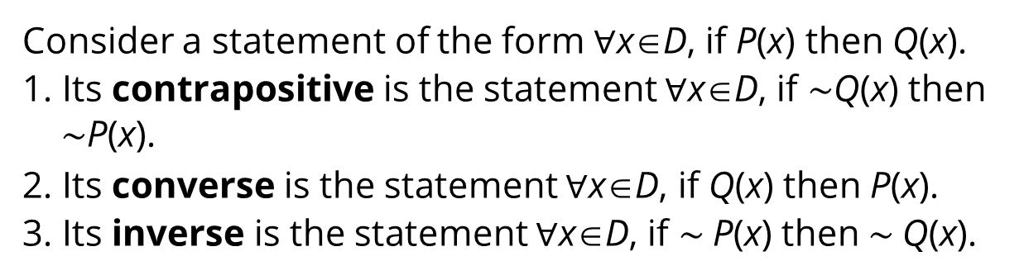
Variants of Universal
Conditional Statements
Definition
Consider a statement of the form ∀x∈D, if P(x) then Q(x).
1. Its contrapositive is the statement ∀x∈D, if $\sim$Q(x) then $\sim$P(x).
2. Its converse is the statement ∀x∈D, if Q(x) then P(x).
3. Its inverse is the statement ∀x∈D, if $\sim$P(x) then $\sim$Q(x).
Example :
Write a formal and an informal contrapositive, converse, and inverse for the following statement :
If a real number is greater than 2, then its square is greater than 4.

Slide 26
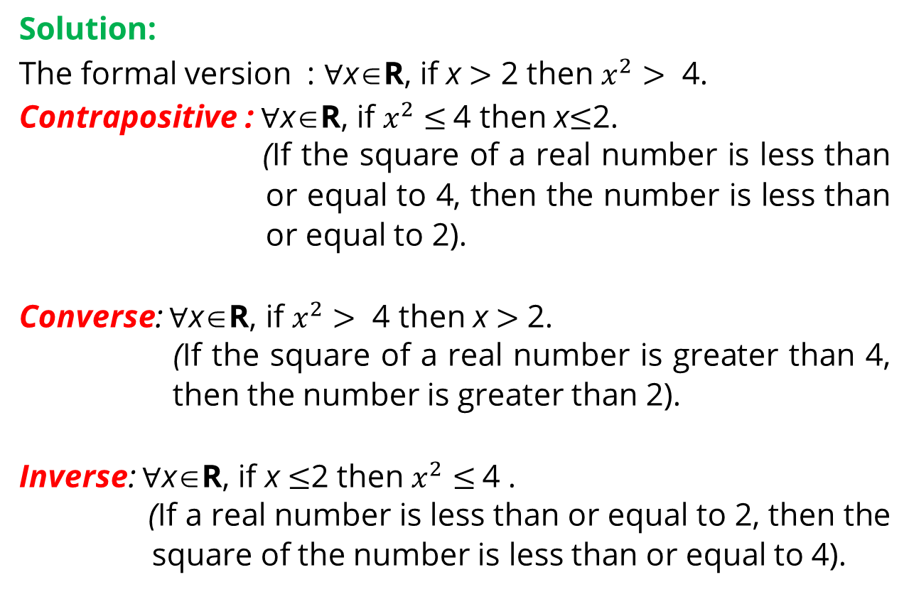
Example
Solution:
The formal version : ∀x∈R, if x $>$ 2 then $x^{2}$ $>$ 4.
Contrapositive : ∀x∈R, if $x^{2}$ $≤$4 then x$≤$2.
(If the square of a real number is less than or equal to 4, then the number is less than or equal to 2).
Converse: ∀x∈R, if $x^{2}$ $>$ 4 then x $>$ 2.
(If the square of a real number is greater than 4, then the number is greater than 2).
Inverse: ∀x∈R, if x $≤$2 then $x^{2}$ $≤$4 .
(If a real number is less than or equal to 2, then the square of the number is less than or equal to 4).

Slide 27
Statements With Multiple Quantifiers
It Is Not Enough To Have A Good Mind. The Main Thing Is To Use It Well. —René Descartes

Slide 28
Multiple Quantifier
∀ x ∀ y P(x,y)
P(x,y) true for all x, y pairs
∃ x ∃ y P(x,y)
P(x,y) true for at least one x, y pair
∀ x ∃ y P(x,y)
For every value of x we can find a (possibly different) y so that P(x,y) is true.
∃ x ∀ y P(x,y)
There is at least one x for which P(x,y) is always true.

Slide 29
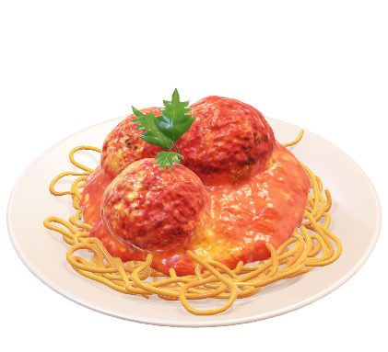
Interpreting Statements with
More Than One Quantifier (1)
Example :
A college cafeteria line has four stations: salads, main courses, desserts, and beverages. The salad station offers a choice of green salad or fruit salad; the main course station offers spaghetti or fish; the dessert station offers pie or cake; and the beverage station offers milk, soda, or coffee. Three students, Uta, Tim, and Yuen, go through the line and make the following choices:
Uta : green salad, spaghetti, pie, milk
Tim : fruit salad, fish, pie, cake, milk, coffee
Yuen : spaghetti, fish, pie, soda

Slide 30
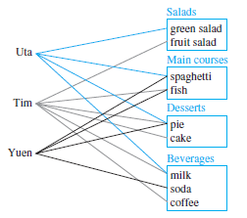
Interpreting Statements with
More Than One Quantifier (2)
These choices are illustrated in this figure :

Slide 31

Example
Write each of following statements informally and find its truth value :
a. ∃ an item I such that ∀ students S, S chose I .
b. ∃ a student S such that ∀ items I, S chose I .
c. ∃ a student S such that ∀ stations Z, ∃ an item I in Z such that S chose I .
d. ∀ students S and ∀ stations Z,
∃ an item I in Z such that S chose I .

Slide 32
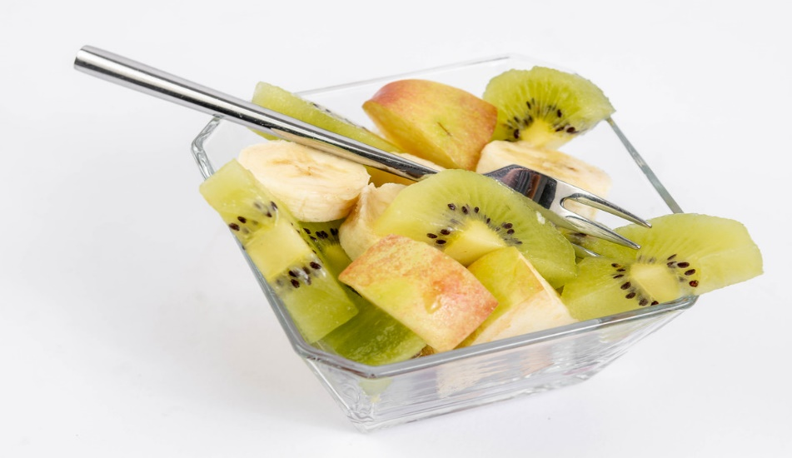
Solution
a. There is an item that was chosen by every student. This is true; every student chose pie.
b. There is a student who chose every available item. This is false; no student chose all nine items.
c. There is a student who chose at least one item from every station. This is true; both Uta and Tim chose at least one item from every station.
d. Every student chose at least
one item from every station.
This is false; Yuen did not
choose a salad. ■
This Photo by Unknown Author is licensed under CC BY

Slide 33
Negations of Statements with
More Than One Quantifier
Negations of Statements with Two Different Quantifiers :
∼(∀x in D,∃y in E such that P(x,y)) ≡ ∃x in D such that ∀ y in E,∼ P(x,y).
∼(∃x in D such that ∀ y in E, P(x,y)) ≡ ∀x in D,∃y in E such that,∼ P(x,y).

Slide 34
References
Susanna S.Epp, “ Discrete Mathematics with Applications”, 5th edition,2020, Cengage, Boston, USA, ISBN 9781337694193
Kenneth H. Rosen, “ Discrete Mathematics and its Applications”, 8th edition,2019, McGraw-Hill Education, New York, ISBN 978-1-259-67651-2

Slide 35
THANK YOU

